Slide 1





Building a Happy Workforce
Strategies for Boosting Employee Satisfaction and Productivity
@ SRC Corporation
Disang (Boys)
Notes:
https://unsplash.com/photos/g9KFpAfQ5bc

Slide 2

Table of content
01
Executive summary
Overview of the case and the solutions
02
Case Analysis
Analysis of the company, competitors, the industry and identifying the pain points
03
Proposed Solutions
Suggesting innovative solutions to bring the company back on track
04
Implementation
Ease of implementing the solutions involving the feasibility and financials
05
Appendix
Ideas, calculations, and their sources

Slide 3
Executive Summary
Analysis
SWOT analysis of SRC Corporation to understand problems and opportunities
Competitor and Industry Analysis to identify key highlights
Short-Term
Quarter 1 –
Understanding phase: Surveys, interviews, and hiring process reviews
Quarter 2-
Employee Development Phase: Skill development, recognition and work environment
Long-Term
Execution
Initiatives raised explanation
Understanding the second pain point i.e. Customer dissatisfaction
Understanding the first pain point i.e. High turnover rate
Quarter 4-
Monitor: Review the plan of action, profit sharing, and other monetary benefits
Quarter 3-
Moving on: Work life balance, health focusing, flexibility
Technological Development:
Learning from Servifast, goal setting, existing tech review, tech roadmap
Customer Satisfaction:
Acknowledging, apologising, improving
Balanced scorecard development
Financial goal setting

Slide 4
SWOT Analysis
SRC Corporation
Strengths
Weaknesses
Large Market Share (25%) - 3rd in its segment
Leading supplier and servicer of autonomous devices and industrial equipment in the USA
The services division is the largest and most profitable division of the company
Strong reputation for high standards of service and product quality
The decline in revenue by 15%
Drop in market share by 3%
Customer Dissatisfaction: Response time (20%) and Overall quality of service (30% of the dissatisfied customers)
Decline in employee job satisfaction: 40% of the company's employees are considering leaving the company
S
W
O
T
Opportunities
Threats
Development of new technologies to improve the efficiency of the company's services
Investment in programs to improve employee satisfaction and retention
Diversification of the company's offerings to enter new markets and expand its customer base
Intense competition from companies such as Servifast and USMech, which have seen an increase in market share over the past year
Reputation at risk
Potential loss of market share
Changes in government regulations or industry standards that could impact the company's operations and profitability
ANALYSIS
SHORT-TERM
LONG-TERM
EXECUTION

Slide 5

Company Analysis
Separation Rate
Turnover Rate
SRC Corporation: what, where, when, and how
It measures the percentage of employees who voluntarily left the organization during the reporting period
Turnover is the rate at which employees leave a company either voluntarily or involuntarily
01
Healthy turnover rate
According to Gallup, a healthy turnover rate is around 10% but it varies based on the industry, company, and retention goals
02
Types of turnover
Voluntary: employees quit their job or resign from the jobs (this is the case with SRC Corporation)
03
Cost of high employee turnover
Monetary: Actively disengaged employees cost the U.S. between $450-550bn per year because they are not as productive as their engaged counterparts
Involuntary: employees are fired due to underperformance or other undesirable activities.
Extremely low turnover might be a cause of harboring detrimental underperformers and may cause frustration among the top performers
Psychological: The remaining workforce is overworked. This affects their mental as well as physical health
Employees leaving the company
Increased working hours for the remaining workforce
Employee dissatisfaction: reduced will to work, less productivity, and less quality of work
Consider leaving the job 40% here
High separation/ turnover rate
Source: US BLS
ANALYSIS
SHORT-TERM
LONG-TERM
EXECUTION

Slide 6




Competitor Analysis
Servifast and USMech vs SRC Corporation
Key observations
Servifast
USMech
SRC Corporation
Competitor market share has increased while SRC experienced a decline.
This means that the problem lies in SRC and not the entire industry
1
3
2
Market share: 35%
Market share has increased by 2% in the given period
Major advantages: innovative and advanced technology offerings
The largest player in the industry
1
3
2
Market share: 30%
Market share has increased by 1% in the given period
Major advantages: excellent customer service and after-sale support
Larger market share than SRC technology
1
3
2
Market share: 25%
Market share has decreased by 3% in the given period
Major drawbacks: response time and quality dissatisfaction, declining revenue
Larger market share than SRC technology
1
3
2
Market share: 25%
Market share has decreased by 3% in the given period
Major drawbacks: response time and quality dissatisfaction, declining revenue
Larger market share than SRC technology
Revenue has seen a major downfall, especially in the service sector, which once used to be the major revenue source
Consumer and employee dissatisfaction have become a major reason for SRC’s revenue downfall. This has led consumers to prefer the competition over SRC
ANALYSIS
SHORT-TERM
LONG-TERM
EXECUTION

Slide 7
The High Turnover
SRC Corporation
Lack of Innovation
Working monotonously and repeating the same tasks feel boring. Seminars and workshops are some great ways to keep the employees updated with the latest technology
Lack of Recognition and Appreciation
The company must value the hardworking employees by rewarding them. This motivates the employees to work even harder
Overwork
When a good chunk of employees leave the company, then rest of the employees are left overworked
Poor Compensation
The overworked employees might not be paid according to how much they work.
They can be given increments time to time
Causes of High Turnover Rate
Inadequate Benefits
The company must offer benefits and allowances like health insurance or occasional gifts to make the employees feel satisfied
Inflexible Work Environment
Some people might have issues coming to the office at some days so the company must be flexible enough to let their employees work from home
ANALYSIS
SHORT-TERM
LONG-TERM
EXECUTION

Slide 8


Pain Points
Employee dissatisfaction
Conducting Seminars and Special Classes frequently
Providing facilities like health insurance
Flexible working conditions
Organizing fun events like trips and appreciating them
Lack of Recognition
Inadequate Benefits
Less training and unaware of new technologies
Overwork
ANALYSIS
SHORT-TERM
LONG-TERM
EXECUTION

Slide 9
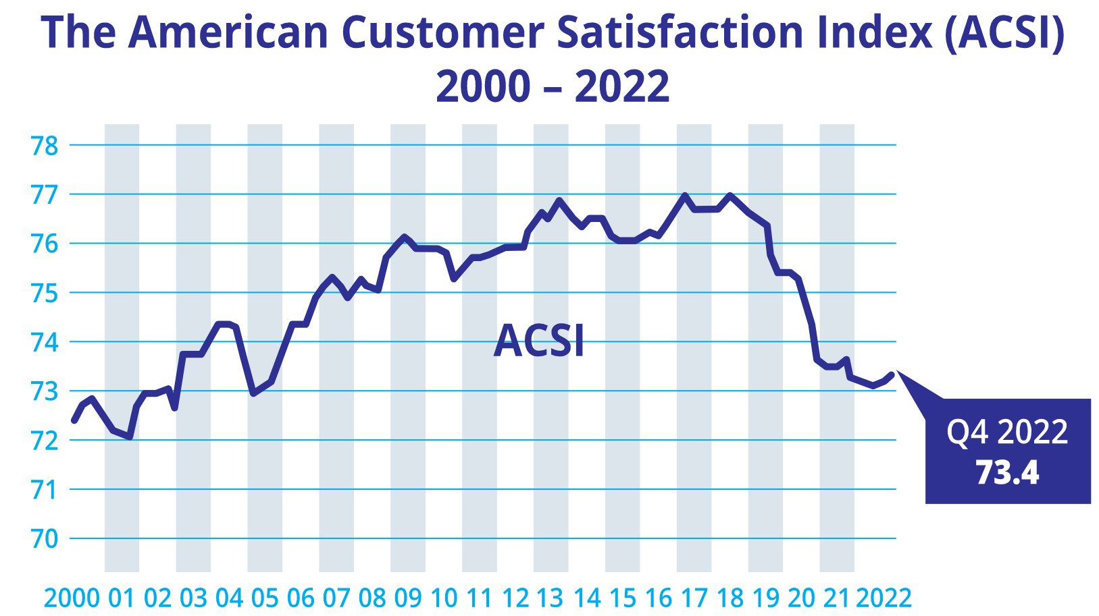
Pain Points
Customer dissatisfaction
Poor Customer Service
Poor build quality and design
Non user-friendly nature
High Expectations by Customers
Overpricing and lack of offers
Customers are switching to competitors
Misleading, false or incomplete information
Company’s declining reputation
Lack of after-sales support
Slow response and rude behavior by employees
Lack of proper feedback system
Lack of Innovation
.
ANALYSIS
SHORT-TERM
LONG-TERM
EXECUTION

Slide 10





Roadmap to success
In-depth 0-12 month Plan-of-Action to get back on track
Identifying issues
Employee development
Evaluate the workload of the overworked employees and assess redistribution, prioritize their tasks, and help them focus on critical projects
Conduct exit interviews with departing employees to find out why they’re leaving
Ensuring that new employees are all set for success
Recognition and rewards program to acknowledge and celebrate employee achievements
Month 0-3
Month 0-3
Exit interviews
Internal surveys
Prioritize and evaluate workload
Review the hiring process
Onboarding program
Employee training
Employee recognition
Positive work environment
Month 4-6
Month 4-6
Internal surveys to understand the problems and recommendations of the current workforce
01
Job description
Revise job descriptions to ensure they accurately reflect job responsibilities and requirements
02
Training for hiring manager
Ensure consistency and fairness in the recruitment and selection process
01
Mentorship program
Facilitate knowledge transfer and support employee development and pro growth
02
Skill development training
Ongoing training and development opportunities to improve employee skills and job satisfaction
Identify areas for improvement
Employee engagement survey
03
Open communication
Share and listen to ideas, feedback, and complaints
Positive culture
Encourage teamwork and respect diversity
Achievements, birthdays, and milestones to promote positivity
Safe workplace
Workplace is clean, safe, and comfortable
Celebrate milestones
Month 7-9
Month 7-9
Considering leaving
Month 10-12
Month 10-12
Employees' will
ANALYSIS
SHORT-TERM
LONG-TERM
EXECUTION

Slide 11












Moving on
Review phase
After an intense execution of the provided plan of action, expecting that the company is now on the path of progress, the profit earned can be split among the workforce.
Implement flexible work arrangements including remote work and flexible schedules
Month 0-3
Month 0-3
Work-life balance
Support employee health
Salary review
Increase flexibility
Compensation and benefits
Profit sharing
Evaluation of progress
Month 4-6
Month 4-6
Overwork can be dealt with by supporting the employees’ mental as well as physical health.
Conduct exit interviews with departing employees to find out why they’re leaving
Provide performance-based bonuses, paid leave, removing pay disparities and other monetary benefits
Regular surveys
Monitor progress and identify areas of improvement
Develop metrics
Track employee turnover rate and satisfaction
Plan-of-action review
Evaluate effectiveness of the plan-of-action
Conduct salary reviews to check employee satisfaction and ensure that pay is competitive with industry standards
Month 7-9
Yoga and meditative programs
Wellness programs
Gym membership
Month 7-9
Month 10-12
Month 10-12
Workload evaluation
Employee training and development
Monetary benefit and profit sharing
Immediate plan of action: Summary
Surveys and interviews
Internal reviews, HR training
Employee health support
ANALYSIS
SHORT-TERM
LONG-TERM
EXECUTION

Slide 12


Long-term solutions and expectations for success
Technological advancement
Take ideas from the industry leader in technology - Servifast
Regaining Consumer Trust
EXPECTATIONS
1
Technology survey
Understanding what the business needs, gaps in technology, and opportunities to streamline growth
01
Improved quality of work
As technology improves, the quality of work improves
02
Reduced process-cycle time
Better tech means reduced process time and hence faster work
Reduced operating costs
03
As tech improves, efficiency increases and costs come down
2
Invest in new software and hardware
Hiring scientists, engineers, and technology experts, and partnering with research institutes and universities
3
Employee training
Ensuring that employees have adequate knowledge about new technology via training programs and course distribution
Process
Customer Satisfaction
Increased Revenue
Sustainability
4
Implement a technology roadmap
Develop a technology roadmap that outlines the initiatives, timeline, budget, and expected outcomes
5
Measure success
Tracking key performance indicators, such as uptime, speed, reliability, and user satisfaction, and making adjustments as needed
GOALS
ANALYSIS
SHORT-TERM
LONG-TERM
EXECUTION

Slide 13


Long-term solutions and expectations for success
Technological advancement
Regaining Consumer Trust
Winning back trust is a long process that requires a consistent and sustained effort from the company
Improvement in technology
Accountability
Once technology improves, service time reduces
Improved technology also leads to a reduction in cost
This may result in cheaper service
Reduced prices will attract more customers and improved service will gain back lost customers
Acknowledging the issue
This shows that the SRC is listening and is committed to finding a solution.
Apologize
SRC understands the impact of the issue on the consumers and is committed to making things right
Provide compensation
This can include refunds, discounts, and other forms of monetary/non-monetary compensation.
Transparent communication
This includes regular updates and providing a timeline for resolution.
Rebuild relationships
This includes reaching out individually, personalized support, and demonstrating a commitment to their satisfaction.
Re-monitor
Include customer feedback surveys to check progress in the implemented measures
Employee satisfaction
The root cause of all the problems was the inefficiency of the employees due to long work hours and job dissatisfaction
Once employee satisfaction is achieved through the 12-month action plan, efficiency will increase
This will ultimately result in better work
ANALYSIS
SHORT-TERM
LONG-TERM
EXECUTION

Slide 14
Balanced Scorecard
 | Objectives | KPIs | Targets | Initiatives
Learning and growth perspective | Improve Employee Skill Reduce Employee Turnover Rate Technological Advancement | Training Index Turnover rate Return on digital investment | Annual increment by 25% Reduce by 4%, 7%, 8%, 8% in 4 quarters Increase by 25% | HR training programs New employee onboard program Technological advancement programs Increase job flexibility
Financial perspective | Increase Revenue Reduce Operating Costs Increase Return on Investment | Revenue Operating Cost ROI | Annual growth of 20% in the service sector and overall growth of 15% Reduce OC by 15% Increase by 4% in 1 year. | Employee satisfaction program Technological advancement => drive down OC and increase ROI
Customer perspective | Increase Customer Satisfaction Reduce Waiting Time Increase Customer Retention/Regain | CSAT score Average Waiting Time Customer Retention | Achieve CSAT score of 75% to get back on track Reduce average waiting time by 20% Customer retention increment by 15% | Customer feedback surveys Increase transparency Technological advancement => reduced waiting time Improved quality of work => customer satisfaction
Internal business perspective | Reduce Process Cycle Time Increase Surveys and Reviews Profit Sharing | Average Cycle Time Net Profit | Reduce by 15% Share 20% of the net profit | Increase automation Monetary benefits
ANALYSIS
SHORT-TERM
LONG-TERM
EXECUTION

Slide 15
Appendix
Employee separation rate by industry
https://www.bls.gov/news.release/jolts.t16.htm
https://www.criteriacorp.com/resources/glossary/turnover-rate
Turnover rate
American customer satisfaction index
https://www.theacsi.org/the-acsi-difference/us-overall-customer-satisfaction/
Separation rate
https://rb.gy/tqaizx
Customer retention rate
https://rb.gy/ukwqwo

Slide 16
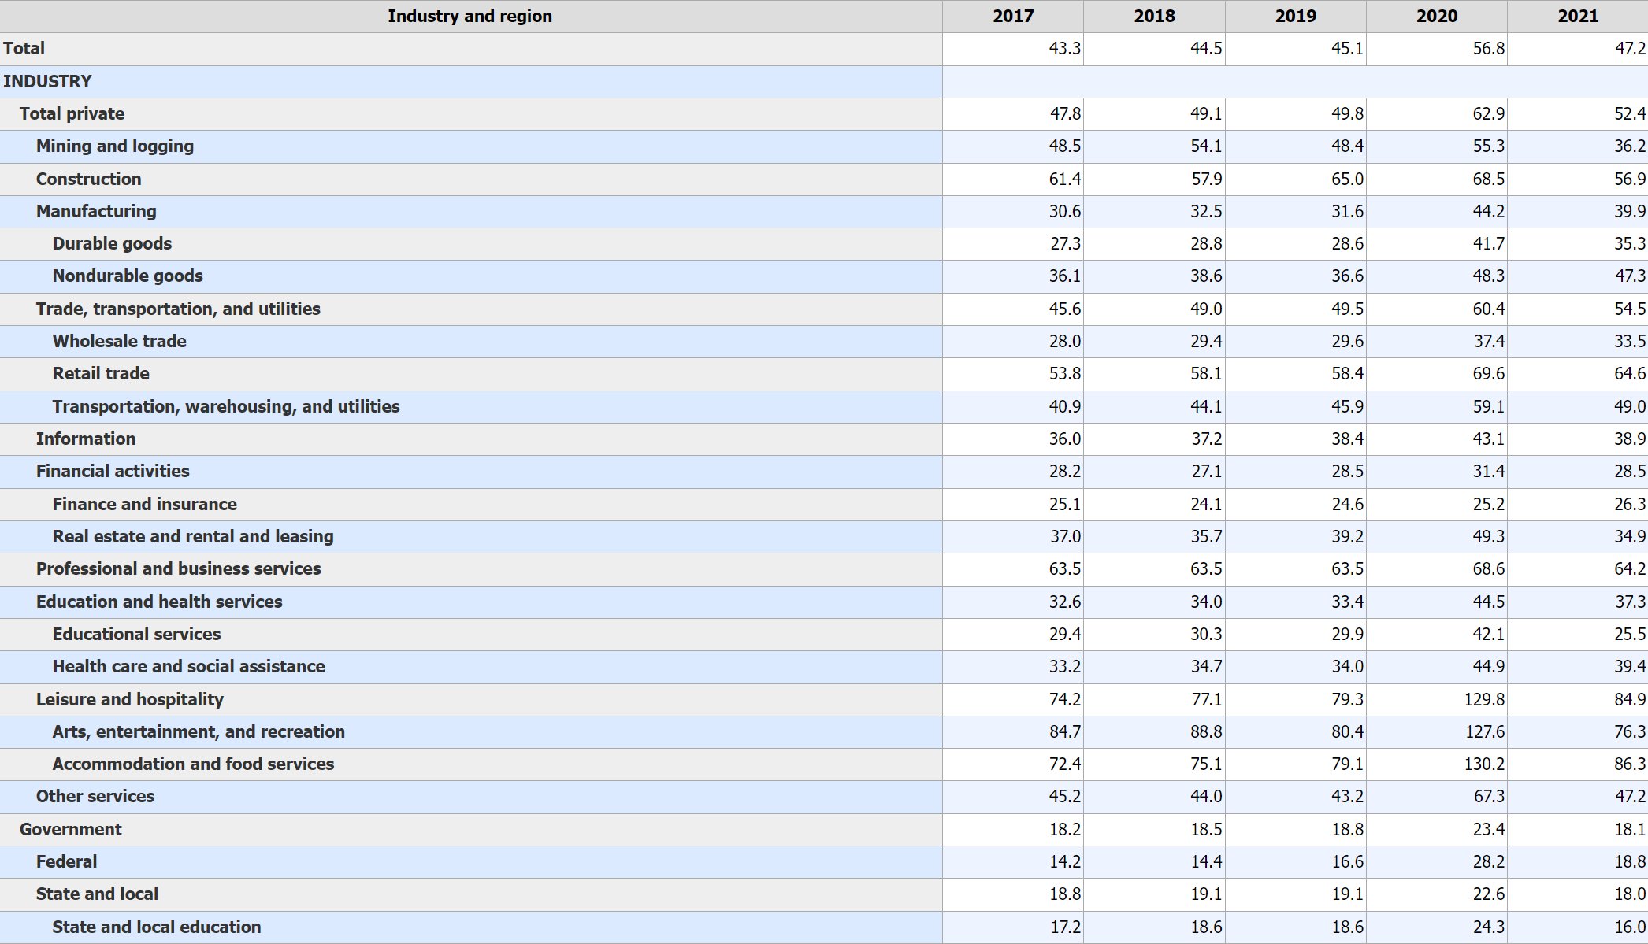
Annual total separations rates by industry and region, not seasonally adjusted

Slide 17

Thank You

